Slide 1

Art Style Classifier Using CNN, SVM, and KMeans
Presented by Shahd Sayed, Zeina Ayman, and Ziad Fehr from the University of Modern Sciences and Arts.

Slide 2
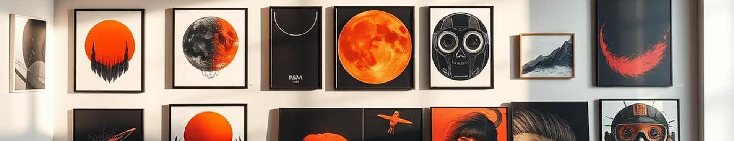
Project Abstract: CNN, SVM, and KMeans for Art Classification
Image Classification
Clustering Approach
Complete Pipeline
Combines CNN for feature extraction and SVM for classification.
KMeans groups similar art styles for unsupervised analysis.
Includes preprocessing, training, evaluation, and a user-friendly GUI.

Slide 3
Introduction to Art Style Classification
Purpose
Challenges
Applications
Automatically identify styles from images of artworks.
Complexity and variability in art styles across cultures and periods.
Enhances curation, digital archiving, and educational tools.

Slide 4

Methodology: CNN Feature Extraction
1
Preprocessing
2
Feature Extraction
3
Layer Details
Normalize and resize images for consistent input.
CNN extracts high-level features representing brush strokes and textures.
Uses multiple convolutional and pooling layers for robust abstraction.

Slide 5
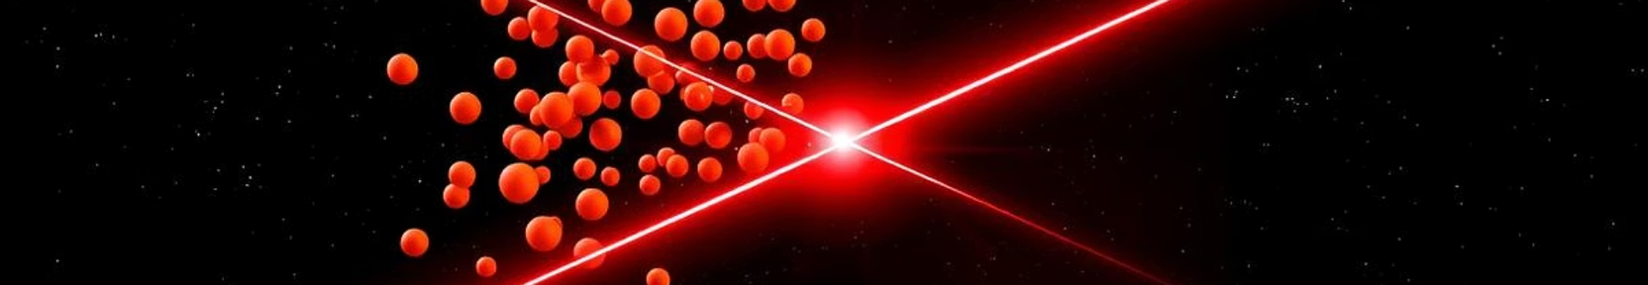



Methodology: SVM Classification
Input
Features extracted by CNN are fed into the SVM.
Training
SVM learns optimal boundaries separating art styles.
Classification
Predicts the art style class of new input images.

Slide 6



Methodology: KMeans Clustering
Clustering
2
KMeans partitions data into clusters based on similarity.
Feature Input
1
Uses CNN features as input vectors.
Visual Insights
Groups reveal patterns and hidden relationships among art styles.
3

Slide 7

Experimental Results and Evaluation
Model | Accuracy | Precision | Recall | F1 | Silhouette
CNN | - | - | - | 72% | -
SVM | 84% | 82% | 80% | 80% | -
K-Means | - | - | - | - | 46%

Slide 8
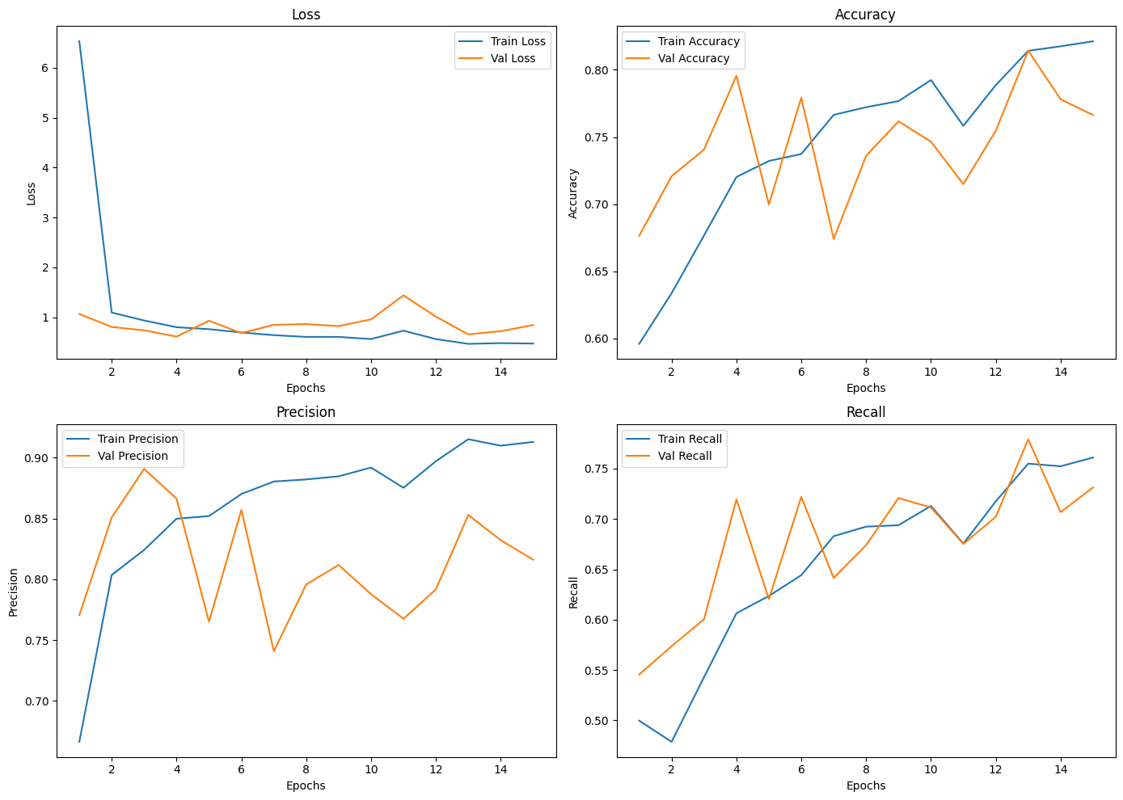
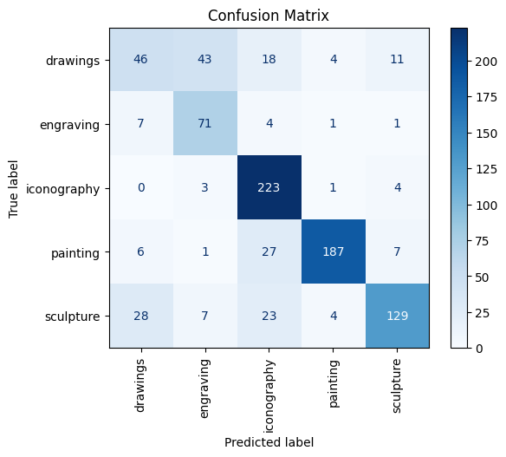
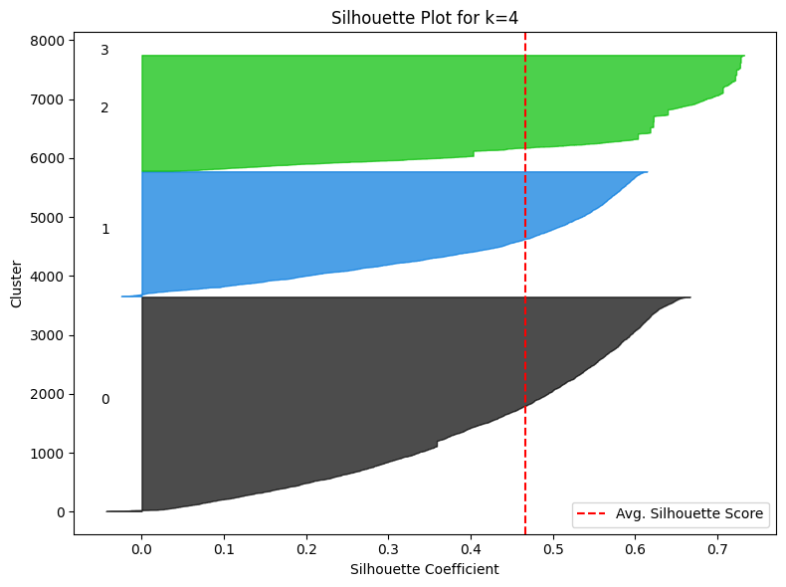
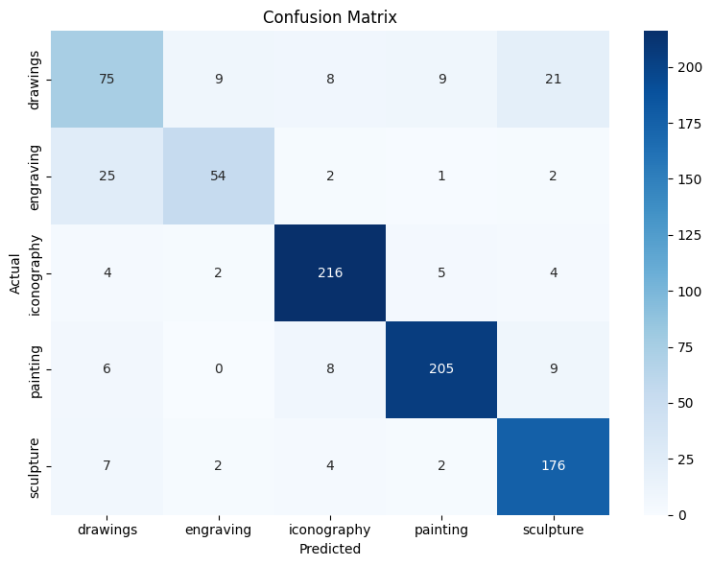

Slide 9

Conclusion and Future Work
Summary
Limitations
Combined CNN, SVM, and KMeans yield strong classification results.
Improvement needed for diverse and rare art styles.
Future Directions
Integrate deeper models and larger datasets, enhance GUI features.

